Slide 1
Scope Sensitive Programming
A short afternoon adventure down memory lane
Eran Talmor
SW Eng. Director
June 6th 2023, Core C++, Tel Aviv

Slide 2
“It's a dangerous business, Frodo, going out your door…”
Bilbo Baggins

Slide 3
ID Card
Age 9: My first PC was a Sinclair ZX Spectrum (BASIC!!!)
C.S. B.Sc Hebrew University, ‘96
Weizmann Institute & Technion MSc. dropout
  (But I didn’t start my own company)
Dev. Formal Verification CAD tools
  @ Intel’s > 13 y
  @ Cadence > 6 y
IDE of choice: vim / tmux
I still love programming, after all these years.

Slide 4
Outline
Motivating Problem + Prescribed Solutions
Hacking the stack: the scoped<> template
  Implementation
  Usage
What else can we do?
  Caching
  Event Counting
  Decorators / Dependency Injection
Drawbacks and an attempts to overcome them
  Shield
  Manifest
Summary

Slide 5
Motivating Problem
Calls for an adventure
A computational SW
Graph in the infrastructure layer
Multiple layers of business logic
Big API Layer
Script thread: heavy, lengthy computations
GUI thread: light, short computations
Scripting Thread
GUI Thread
API
Business Logic / Flows
…
…
Graph Infrastructure
How do we set different thresholds from the Scripting and GUI thread?

Slide 6
Prescribed Solutions
Solution | Issues
Graph configuration APIs: scripting: … graph.set_thresh(42000) GUI: … graph.set_thresh(42) | Thread safety needs special attention Need to restore previous value after lock Either Locking graph for long “scripting” operations Or reconfigure on every short lock
Reachitecture: per-thread graph “view” | Hard to maintain state consistency Scripting + GUI want to refer to same graph node identifiers and manipulate them consistently
Passing arguments | Change dozens of functions/methods, multiple layers Headers polluted with low level arguments

Slide 7
Prescribed Solutions
Probably Good…
But I promised an adventure!

Slide 8
Outline
Motivating Problem + Prescribed Solutions
Hacking the stack: the scoped<> template
  Implementation
  Usage
What else can we do?
  Caching
  Event Counting
  Decorators / Dependency Injection
Drawbacks and an attempts to overcome them
  Shield
  Manifest
Summary

Slide 9
Hacking the Stack: the scoped<> template
Introducing:
template <class T, class ...Tags> class scoped { … }
T is the type of value being wrapped
Tags are used to differentiate different instances
using ScopedThreshold = scoped<int, struct ScopedThresholdTag>
Scoped values must be put on the stack.

Slide 10
scoped<> template implementation
Doubly-Linked list embedded in the call-stack
Each template instance <data, tags…> is separate
Thread-local static pointer to the current top / bottom
maintained by CTOR and DTOR
void f1 {
ScopedThresh thresh(30);
f2();
}
void f2() {
f3();
}
void f3() {
ScopedThresh thresh(60);
}
nullptr
next
ScopedThresh::s_bottom
thresh(30)
f1
prev
next
// skipped
f2
thresh(60)
prev
f3
ScopedThresh::s_top
nullptr

Slide 11
scoped<> template usage
using ScopedThreshold = scoped::scoped<int, struct ScopedThresholdTag>;
void print_number(int x) {
std::cout << "The number is ";
if (auto thresh = ScopedThreshold::top()) {
if (x >= thresh->value()) {
std::cout << "BIG" << std::endl;
return;
}
}
std::cout << x << std::endl;
}
int main() {
{
ScopedThreshold scoped_threshold{4};
print_number(3); // Expected: The number is 3
print_number(10); // Expected: The number is BIG
}
print_number(10); // Expected: The number is 10
return 0;
}

Slide 12
scoped<> template usage
using ScopedThreshold = scoped::scoped<int, struct ScopedThresholdTag>;
void print_number(int x) {
std::cout << "The number is ";
if (auto thresh = ScopedThreshold::top()) {
if (x >= thresh->value()) {
std::cout << "BIG" << std::endl;
return;
}
}
std::cout << x << std::endl;
}
--> int main() {
{
ScopedThreshold scoped_threshold{4};
print_number(3); // Expected: The number is 3
print_number(10); // Expected: The number is BIG
}
print_number(10); // Expected: The number is 10
return 0;
}
nullptr
ScopedThresh::s_bottom
main
ScopedThresh::s_top
nullptr

Slide 13
scoped<> template usage
using ScopedThreshold = scoped::scoped<int, struct ScopedThresholdTag>;
void print_number(int x) {
std::cout << "The number is ";
if (auto thresh = ScopedThreshold::top()) {
if (x >= thresh->value()) {
std::cout << "BIG" << std::endl;
return;
}
}
std::cout << x << std::endl;
}
int main() {
--> {
ScopedThreshold scoped_threshold{4};
print_number(3); // Expected: The number is 3
print_number(10); // Expected: The number is BIG
}
print_number(10); // Expected: The number is 10
return 0;
}
nullptr
ScopedThresh::s_bottom
{
}
main
ScopedThresh::s_top
nullptr

Slide 14
scoped<> template usage
using ScopedThreshold = scoped::scoped<int, struct ScopedThresholdTag>;
void print_number(int x) {
std::cout << "The number is ";
if (auto thresh = ScopedThreshold::top()) {
if (x >= thresh->value()) {
std::cout << "BIG" << std::endl;
return;
}
}
std::cout << x << std::endl;
}
int main() {
{
--> ScopedThreshold scoped_threshold{4};
print_number(3); // Expected: The number is 3
print_number(10); // Expected: The number is BIG
}
print_number(10); // Expected: The number is 10
return 0;
}
nullptr
next
ScopedThresh::s_bottom
{
scoped_threshold(4)
}
main
prev
ScopedThresh::s_top
nullptr

Slide 15
scoped<> template usage
using ScopedThreshold = scoped::scoped<int, struct ScopedThresholdTag>;
void print_number(int x) {
std::cout << "The number is ";
if (auto thresh = ScopedThreshold::top()) {
if (x >= thresh->value()) {
std::cout << "BIG" << std::endl;
return;
}
}
std::cout << x << std::endl;
}
int main() {
{
ScopedThreshold scoped_threshold{4};
--> print_number(3); // Expected: The number is 3
print_number(10); // Expected: The number is BIG
}
print_number(10); // Expected: The number is 10
return 0;
}
nullptr
next
ScopedThresh::s_bottom
{
scoped_threshold(4)
}
main
prev
ScopedThresh::s_top
nullptr

Slide 16
scoped<> template usage
The number is 3
using ScopedThreshold = scoped::scoped<int, struct ScopedThresholdTag>;
void print_number(int x) {
std::cout << "The number is ";
if (auto thresh = ScopedThreshold::top()) {
if (x >= thresh->value()) {
std::cout << "BIG" << std::endl;
return;
}
}
std::cout << x << std::endl;
}
int main() {
{
ScopedThreshold scoped_threshold{4};
print_number(3); // Expected: The number is 3
--> print_number(10); // Expected: The number is BIG
}
print_number(10); // Expected: The number is 10
return 0;
}
nullptr
next
ScopedThresh::s_bottom
{
scoped_threshold(4)
}
main
prev
ScopedThresh::s_top
nullptr

Slide 17
scoped<> template usage
The number is 3
using ScopedThreshold = scoped::scoped<int, struct ScopedThresholdTag>;
void print_number(int x) {
--> std::cout << "The number is ";
if (auto thresh = ScopedThreshold::top()) {
if (x >= thresh->value()) {
std::cout << "BIG" << std::endl;
return;
}
}
std::cout << x << std::endl;
}
int main() {
{
ScopedThreshold scoped_threshold{4};
print_number(3); // Expected: The number is 3
print_number(10); // Expected: The number is BIG
}
print_number(10); // Expected: The number is 10
return 0;
}
nullptr
next
ScopedThresh::s_bottom
{
scoped_threshold(4)
}
main
prev
print_number
ScopedThresh::s_top
nullptr

Slide 18
scoped<> template usage
The number is 3
The number is
using ScopedThreshold = scoped::scoped<int, struct ScopedThresholdTag>;
void print_number(int x) {
std::cout << "The number is ";
--> if (auto thresh = ScopedThreshold::top()) {
if (x >= thresh->value()) {
std::cout << "BIG" << std::endl;
return;
}
}
std::cout << x << std::endl;
}
int main() {
{
ScopedThreshold scoped_threshold{4};
print_number(3); // Expected: The number is 3
print_number(10); // Expected: The number is BIG
}
print_number(10); // Expected: The number is 10
return 0;
}
nullptr
next
ScopedThresh::s_bottom
{
scoped_threshold(4)
}
main
prev
if (…) { }
print_number
ScopedThresh::s_top
nullptr

Slide 19
scoped<> template usage
The number is 3
The number is
using ScopedThreshold = scoped::scoped<int, struct ScopedThresholdTag>;
void print_number(int x) {
std::cout << "The number is ";
if (auto thresh = ScopedThreshold::top()) {
--> if (x >= thresh->value()) {
std::cout << "BIG" << std::endl;
return;
}
}
std::cout << x << std::endl;
}
int main() {
{
ScopedThreshold scoped_threshold{4};
print_number(3); // Expected: The number is 3
print_number(10); // Expected: The number is BIG
}
print_number(10); // Expected: The number is 10
return 0;
}
nullptr
next
ScopedThresh::s_bottom
{
scoped_threshold(4)
}
main
prev
if (…) { if(…) { } }
print_number
ScopedThresh::s_top
nullptr

Slide 20
scoped<> template usage
The number is 3
The number is
using ScopedThreshold = scoped::scoped<int, struct ScopedThresholdTag>;
void print_number(int x) {
std::cout << "The number is ";
if (auto thresh = ScopedThreshold::top()) {
if (x >= thresh->value()) {
--> std::cout << "BIG" << std::endl;
return;
}
}
std::cout << x << std::endl;
}
int main() {
{
ScopedThreshold scoped_threshold{4};
print_number(3); // Expected: The number is 3
print_number(10); // Expected: The number is BIG
}
print_number(10); // Expected: The number is 10
return 0;
}
nullptr
next
ScopedThresh::s_bottom
{
scoped_threshold(4)
}
main
prev
if (…) { if(…) { } }
print_number
ScopedThresh::s_top
nullptr

Slide 21
scoped<> template usage
The number is 3
The number is BIG
using ScopedThreshold = scoped::scoped<int, struct ScopedThresholdTag>;
void print_number(int x) {
std::cout << "The number is ";
if (auto thresh = ScopedThreshold::top()) {
if (x >= thresh->value()) {
std::cout << "BIG" << std::endl;
--> return;
}
}
std::cout << x << std::endl;
}
int main() {
{
ScopedThreshold scoped_threshold{4};
print_number(3); // Expected: The number is 3
print_number(10); // Expected: The number is BIG
}
print_number(10); // Expected: The number is 10
return 0;
}
nullptr
next
ScopedThresh::s_bottom
{
scoped_threshold(4)
}
main
prev
if (…) { if(…) { } }
print_number
ScopedThresh::s_top
nullptr

Slide 22
scoped<> template usage
The number is 3
The number is BIG
using ScopedThreshold = scoped::scoped<int, struct ScopedThresholdTag>;
void print_number(int x) {
std::cout << "The number is ";
if (auto thresh = ScopedThreshold::top()) {
if (x >= thresh->value()) {
std::cout << "BIG" << std::endl;
return;
}
}
std::cout << x << std::endl;
--> }
int main() {
{
ScopedThreshold scoped_threshold{4};
print_number(3); // Expected: The number is 3
print_number(10); // Expected: The number is BIG
}
print_number(10); // Expected: The number is 10
return 0;
}
nullptr
next
ScopedThresh::s_bottom
{
scoped_threshold(4)
}
main
prev
print_number
ScopedThresh::s_top
nullptr

Slide 23
scoped<> template usage
The number is 3
The number is BIG
using ScopedThreshold = scoped::scoped<int, struct ScopedThresholdTag>;
void print_number(int x) {
std::cout << "The number is ";
if (auto thresh = ScopedThreshold::top()) {
if (x >= thresh->value()) {
std::cout << "BIG" << std::endl;
return;
}
}
std::cout << x << std::endl;
}
int main() {
{
ScopedThreshold scoped_threshold{4};
print_number(3); // Expected: The number is 3
print_number(10); // Expected: The number is BIG
--> }
print_number(10); // Expected: The number is 10
return 0;
}
nullptr
next
ScopedThresh::s_bottom
{
scoped_threshold(4)
}
main
prev
ScopedThresh::s_top
nullptr

Slide 24
scoped<> template usage
The number is 3
The number is BIG
using ScopedThreshold = scoped::scoped<int, struct ScopedThresholdTag>;
void print_number(int x) {
std::cout << "The number is ";
if (auto thresh = ScopedThreshold::top()) {
if (x >= thresh->value()) {
std::cout << "BIG" << std::endl;
return;
}
}
std::cout << x << std::endl;
}
int main() {
{
ScopedThreshold scoped_threshold{4};
print_number(3); // Expected: The number is 3
print_number(10); // Expected: The number is BIG
}
--> print_number(10); // Expected: The number is 10
return 0;
}
nullptr
ScopedThresh::s_bottom
main
ScopedThresh::s_top
nullptr

Slide 25
scoped<> template usage
The number is 3
The number is BIG
using ScopedThreshold = scoped::scoped<int, struct ScopedThresholdTag>;
void print_number(int x) {
--> std::cout << "The number is ";
if (auto thresh = ScopedThreshold::top()) {
if (x >= thresh->value()) {
std::cout << "BIG" << std::endl;
return;
}
}
std::cout << x << std::endl;
}
int main() {
{
ScopedThreshold scoped_threshold{4};
print_number(3); // Expected: The number is 3
print_number(10); // Expected: The number is BIG
}
print_number(10); // Expected: The number is 10
return 0;
}
nullptr
ScopedThresh::s_bottom
main
print_number
ScopedThresh::s_top
nullptr

Slide 26
scoped<> template usage
The number is 3
The number is BIG
The number is
using ScopedThreshold = scoped::scoped<int, struct ScopedThresholdTag>;
void print_number(int x) {
std::cout << "The number is ";
--> if (auto thresh = ScopedThreshold::top()) {
if (x >= thresh->value()) {
std::cout << "BIG" << std::endl;
return;
}
}
std::cout << x << std::endl;
}
int main() {
{
ScopedThreshold scoped_threshold{4};
print_number(3); // Expected: The number is 3
print_number(10); // Expected: The number is BIG
}
print_number(10); // Expected: The number is 10
return 0;
}
nullptr
ScopedThresh::s_bottom
main
print_number
ScopedThresh::s_top
nullptr

Slide 27
scoped<> template usage
The number is 3
The number is BIG
The number is
using ScopedThreshold = scoped::scoped<int, struct ScopedThresholdTag>;
void print_number(int x) {
std::cout << "The number is ";
if (auto thresh = ScopedThreshold::top()) {
if (x >= thresh->value()) {
std::cout << "BIG" << std::endl;
return;
}
}
--> std::cout << x << std::endl;
}
int main() {
{
ScopedThreshold scoped_threshold{4};
print_number(3); // Expected: The number is 3
print_number(10); // Expected: The number is BIG
}
print_number(10); // Expected: The number is 10
return 0;
}
nullptr
ScopedThresh::s_bottom
main
print_number
ScopedThresh::s_top
nullptr

Slide 28
scoped<> template usage
The number is 3
The number is BIG
The number is 10
using ScopedThreshold = scoped::scoped<int, struct ScopedThresholdTag>;
void print_number(int x) {
std::cout << "The number is ";
if (auto thresh = ScopedThreshold::top()) {
if (x >= thresh->value()) {
std::cout << "BIG" << std::endl;
return;
}
}
std::cout << x << std::endl;
--> }
int main() {
{
ScopedThreshold scoped_threshold{4};
print_number(3); // Expected: The number is 3
print_number(10); // Expected: The number is BIG
}
print_number(10); // Expected: The number is 10
return 0;
}
nullptr
ScopedThresh::s_bottom
main
print_number
ScopedThresh::s_top
nullptr

Slide 29
scoped<> template usage
The number is 3
The number is BIG
The number is 10
using ScopedThreshold = scoped::scoped<int, struct ScopedThresholdTag>;
void print_number(int x) {
std::cout << "The number is ";
if (auto thresh = ScopedThreshold::top()) {
if (x >= thresh->value()) {
std::cout << "BIG" << std::endl;
return;
}
}
std::cout << x << std::endl;
}
int main() {
{
ScopedThreshold scoped_threshold{4};
print_number(3); // Expected: The number is 3
print_number(10); // Expected: The number is BIG
}
print_number(10); // Expected: The number is 10
--> return 0;
}
nullptr
ScopedThresh::s_bottom
main
ScopedThresh::s_top
nullptr

Slide 30
Outline
Motivating Problem + Prescribed Solutions
Hacking the stack: the scoped<> template
  Implementation
  Usage
What else can we do?
  Caching
  Event Counting
  Decorators / Dependency Injection
Drawbacks and an attempts to overcome them
  Shield
  Manifest
Summary

Slide 31
Caching
Many computations modules enjoy caching:
  E.g. is_prime(int number)
Caching best determined by the consumer of a function/module
scoped<> can help set caching at different levels/scopes
In our example, is_prime() prefers the outer most scope
// Create a new scoped cache for caching prime numbers
using ScopedPrimeCache = scoped::scoped<std::unordered_map<int, bool>,
struct ScopedPrimeCacheTag>;

Slide 32


Caching is_prime using a scoped cache
// Check if a given number is a prime number
bool is_prime(int n) {
if (n < 2) return false;
// Retrieve the prime number cache, taking the bottom (outer) most scope
auto pScopedCache = ScopedPrimeCache::bottom();
// If previously cached, return the result
if (pScopedCache) {
auto& cache = pScopedCache->value();
if (auto it = cache.find(n); it != cache.end()) {
std::cout << "Cache hit for " << n << std::endl;
return it->second;
}
}
// Calculate whether the number is prime or not, and cache the result
…

Slide 33
Intermediate functions using is_prime, unaware of caching
// Find the next prime number greater than a given number
int next_prime(int n) {
int k = n+1;
for (; !is_prime(k); k++);
return k;
}
// Find the first n prime numbers
std::vector<int> first_n_primes(int n) {
std::vector<int> primes;
int p = 0;
for (int i=0; i < n; ++i) {
p = next_prime(p);
primes.push_back(p);
}
return primes;
}

Slide 34
is_prime: setting up the cache
int main()
{
// Create a new scoped cache for caching prime numbers
ScopedPrimeCache primeCache;
first_n_primes(5);
for (auto p : first_n_primes(10)) // 5 cache hits
{
std::cout << p << std::endl;
}
}

Slide 35
Outline
Motivating Problem + Prescribed Solutions
Hacking the stack: the scoped<> template
  Implementation
  Usage
What else can we do?
  Caching
  Event Counting
  Decorators / Dependency Injection
Drawbacks and an attempts to overcome them
  Shield
  Manifest
Summary

Slide 36
Event Counting
Event counting is often used to collect usage statistics
  Internal code (debug, performance, architecture)
  External users (support, marketing)
Event counting may interest different scopes
  How many X events occurred in function Y?
  How many Z events occurred in thread W?
Scoped<> solves this easily
Example: Simple Calculator

Slide 37
Event Counting
class Calculator {
public:
enum Event {
ADD=0, SUB=1, MUL=2, DIV=3
};
class Counter {
public:
void increment(Event event) { count_[event]++; }
void report(const std::string& prefix) {
std::cout << prefix
<< " ADD: " << count_[ADD]
<< " SUB: " << count_[SUB]
<< " MUL: " << count_[MUL]
<< " DIV: " << count_[DIV] << std::endl;
}
private:
std::vector<int> count_ = {0,0,0,0};
};
using ScopedCounter = scoped::scoped<Counter, struct ScopedCounterTag>;

Slide 38
Event Counting (inside the Calculator class)
public:
void add(double x) {
increment(ADD);
result_ += x;
}
void subtract(double x) {
increment(SUB);
result_ -= x;
}
...
private:
// Increment event count in all currently scoped counters
void increment(Event event) {
for (auto pScopedCounter = ScopedCounter::top(); pScopedCounter;
pScopedCounter = pScopedCounter->next()) {
pScopedCounter->value().increment(event);
}
}

Slide 39
Event Counting: used by nested scopes
double average(const std::vector<double>& v, Calculator& calc) {
Calculator::ScopedCounter counter;
calc.clear();
for (double val : v) {
calc.add(val);
}
calc.divide(v.size());
counter.value().report("calc event count in average(): ");
return calc.getResult();
}
int main()
{
Calculator calc;
Calculator::ScopedCounter counter;
auto avg = average({1.0, 2.0, 3.0, 4.0, 5.0}, calc);
std::cout << "Average: " << avg << std::endl;
calc.clear(); calc.add(2); calc.multiply(3); calc.multiply(7);
std::cout << "The meaning of life is: " << calc.getResult() << std::endl;
counter.value().report("Total calc event count in main():");
}

Slide 40
Outline
Motivating Problem + Prescribed Solutions
Hacking the stack: the scoped<> template
  Implementation
  Usage
What else can we do?
  Caching
  Event Counting
  Decorators / Dependency Injection
Drawbacks and an attempts to overcome them
  Shield
  Manifest
Summary

Slide 41
Decorators / Dependency Injection
Decorators are used here to “decorate” log messages:
  Upper case / Lowercase
  Indent
  Prefix, suffix, etc…
Polymorphic by nature
A logger is shared between two threads, each setting its own decoration
scoped<> supports polymorphism:
In fact:
TextDecorator
UpperCaseDecorator
LowerCaseDecorator
IndentDecorator
using ScopedDecorator = abstract_scoped<TextDecorator>;
using ScopedUpperCaseDecorator = polymorphic_scoped<UpperCaseDecorator, TextDecorator>;
using ScopedLowerCaseDecorator = polymorphic_scoped<LowerCaseDecorator, TextDecorator>;
using ScopedIndentDecorator = polymorphic_scoped<IndentDecorator, TextDecorator>;
template<class T, class ...Tags> using scoped = polymorphic_scoped<T, T, Tags...>;

Slide 42
Decorators / Dependency Injection
// Define a logging function that uses scoped<> to apply the decorators
void log(const std::string& message) {
// Use the Scoped<> type to apply the decorators to the message
std::string decoratedMessage = message;
for (auto pScope = ScopedDecorator::top(); pScope; pScope = pScope->next()) {
decoratedMessage = pScope->value().apply(decoratedMessage);
}
// Synchronize access to the standard output and print the decorated message
static std::mutex logMutex;
std::lock_guard<std::mutex> lock(logMutex);
std::cout << decoratedMessage << std::endl;
}

Slide 43
Decorators – used by two threads
void threadFunc1() {
ScopedUpperCaseDecorator upper;
for (int i = 0; i < 5; ++i) {
log("Thread 1: This message is upper case");
std::this_thread::sleep_for(std::chrono::milliseconds(50));
}
}
void threadFunc2() {
ScopedIndentDecorator indent;
ScopedLowerCaseDecorator lower;
for (int i = 0; i < 5; ++i) {
log("Thread 2: This message is upper case\nand indented");
std::this_thread::sleep_for(std::chrono::milliseconds(100));
}
}

Slide 44
Decorators – used by two threads
THREAD 1: THIS MESSAGE IS UPPER CASE
thread 2: this message is upper case
and indented
THREAD 1: THIS MESSAGE IS UPPER CASE
THREAD 1: THIS MESSAGE IS UPPER CASE
thread 2: this message is upper case
and indented
THREAD 1: THIS MESSAGE IS UPPER CASE
THREAD 1: THIS MESSAGE IS UPPER CASE
thread 2: this message is upper case
and indented
thread 2: this message is upper case
and indented
thread 2: this message is upper case
and indented
void threadFunc1() {
ScopedUpperCaseDecorator upper;
for (int i = 0; i < 5; ++i) {
log("Thread 1: This message is upper case");
std::this_thread::sleep_for(std::chrono::milliseconds(50));
}
}
void threadFunc2() {
ScopedIndentDecorator indent;
ScopedLowerCaseDecorator lower;
for (int i = 0; i < 5; ++i) {
log("Thread 2: This message is upper case\nand indented");
std::this_thread::sleep_for(std::chrono::milliseconds(100));
}
}

Slide 45
Outline
Motivating Problem + Prescribed Solutions
Hacking the stack: the scoped<> template
  Implementation
  Usage
What else can we do?
  Caching
  Event Counting
  Decorators
  Dependency Injection
Drawbacks and an attempts to overcome them
  Shield
  Manifest
Summary

Slide 46
“A good adventure must have a few dragons”
Y. Truly

Slide 47
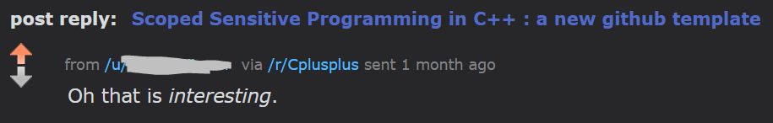

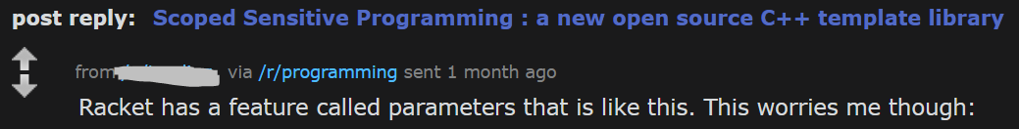
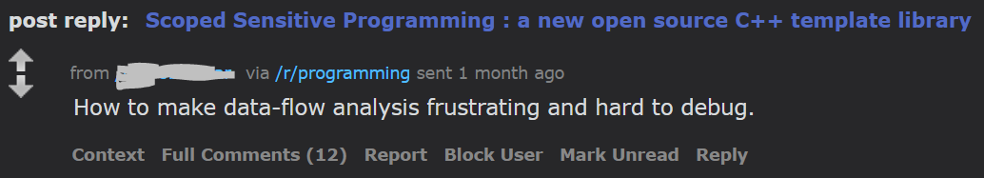
Drawbacks and an attempt to overcome there
Some /r/programming subreddit-ers warm response:

Slide 48
scoped<T>::shield
A scoped<T>::shield protects your scope from external effects
Sets s_top=s_bottom=nullptr in CTOR
returns previous pointers in DTOR
Useful for:
  Debugging
  Scopes that require special care
  I trust myself to use scope<> in my implementation,
  but NOT users of my module.

Slide 49
scoped<T>::shield – threshold example
int main() {
{
ScopedThreshold scoped_threshold{4};
print_number(3); // Expected: 3
print_number(10); // Expected: BIG
{
ScopedThreshold::shield shield;
print_number(10); // Expected: 10
}
print_number(10); // Expected: BIG
}
print_number(10); // Expected: 10
return 0;
}

Slide 50
Outline
Motivating Problem + Prescribed Solutions
Hacking the stack: the scoped<> template
  Implementation
  Usage
What else can we do?
  Caching
  Event Counting
  Decorators
  Dependency Injection
Drawbacks and an attempts to overcome them
  Shield
  Manifest
Summary

Slide 51
Manifest
One of the problems with scoped<> is that they are not explicitly “published”.
Using type traits, “manifest” structs can be associated with classes, methods, and functions.
The following macros are provided:
template <typename T> using scoped_manifest_of = decltype(__get_scoped_manifest_traits((T*)nullptr));
template <typename F, F f> struct __scoped_function_type__ {};
#define SCOPED_FUNCTION_TYPE(f) __scoped_function_type__<decltype(&f), &f>
#define SCOPED_DECLARE_CLASS_MANIFEST(Class, Manifest) Manifest __get_scoped_manifest_traits(Class *);
#define SCOPED_DECLARE_FUNCTION_MANIFEST(Func, Manifest) Manifest \ __get_scoped_manifest_traits(SCOPED_FUNCTION_TYPE(Func)*);
#define SCOPED_GET_CLASS_MANIFEST(Class) scoped_manifest_of<Class>
#define SCOPED_GET_OBJECT_MANIFEST(Obj) scoped_manifest_of<decltype(Obj)>
#define SCOPED_GET_FUNCTION_MANIFEST(Func) scoped_manifest_of<SCOPED_FUNCTION_TYPE(Func)>

Slide 52
Adding a manifest to a function
// Header
struct get_number_manifest {
using Thresh = scoped::scoped<int, struct ThresholdTag>;
};
int get_number(int x); // FWD declaration
SCOPED_DECLARE_FUNCTION_MANIFEST(get_number, get_number_manifest);
// Body
int get_number(int x) {
if (auto thresh = SCOPED_GET_FUNCTION_MANIFEST(get_number)::Thresh::top()) {
if (x >= thresh->value()) {
return -1;
}
}
return x;
}

Slide 53
Using a manifested scoped variable
// User of get_number
int main() {
{
SCOPED_GET_FUNCTION_MANIFEST(get_number)::Thresh scoped_threshold(4);
assert(get_number(3) == 3);
assert(get_number(10) == -1);
}
assert(get_number(10) == 10);
return 0;
}

Slide 54
Outline
Motivating Problem + Prescribed Solutions
Hacking the stack: the scoped<> template
  Implementation
  Usage
What else can we do?
  Caching
  Event Counting
  Decorators
  Dependency Injection
Drawbacks and an attempts to overcome them
  Shield
  Manifest
Summary

Slide 55
Summary: scoped<> pros / cons
Pros
Cons
Flexible, supporting multiple use-cases
Thread Safe
Fast – no locks
No need to set/reset configurations
Hide low-level details from header files
Polymorphic
Easy to apply to existing code
Changes the code, not architecture
Intuitive?
Easy to maintain
Provide hidden knobs / side channel
  “Manifests” may help
Code prone to external effects
  “shields” may help
If not used carefully, may lead to bad coding
Don’t use instead of arguments!!!

Slide 56
Summary
We had a short adventure combining the stack x thread local data x templates.
It’s a good exercise to “bend the rules” from time to time
Experiment: It’s fun and educating
Welcome feedback!
I hope to leave you with some questions …
  In what other ways can data be known?
  Can some complex design patterns be simplified,
  by changing their underlying assumptions?
  What features can we combine to create new ideas?
  What untraveled paths are left to explore?

Slide 57

Q&A
https://github.com/erangithub/scoped

Slide 58
THANK YOU!
https://github.com/erangithub/scoped

Slide 59


Slide 60
backup

Slide 61
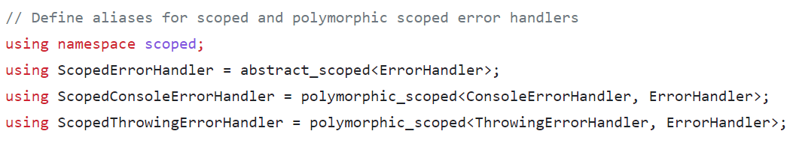



Dependency Injection – div by zero Error handler
Again, polymorphic_scoped is used for dependency injection:

Slide 62
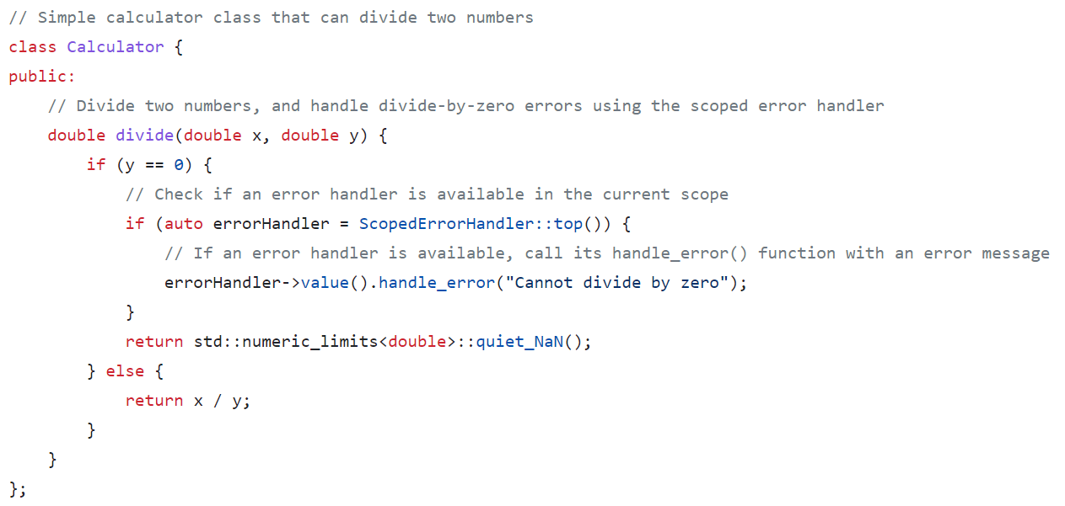


Dependency Injection – div by zero Error handler
Notes:
The decorators are a type of dependency injection
Another example: error handing

